Slide 1
Housing Affordability in the Des Moines Metropolitan Area
Mackenzie Locey

Slide 2
Initial Goals
Create a Leaflet map with layers that show population, median household income, percent of income spent on housing, owner-occupied vacancy rate, renter-occupied vacancy rate, and total housing units for the DSM-MSA
Leaflet
GeoJSON
JQuery

Slide 3
Difficulties along the way
I had to condense down data that included every city in Iowa, which took up most of my time for the project.
I had to troubleshoot a little bit on how to get the geoJSON into my script and have it show the way I wanted to.

Slide 4
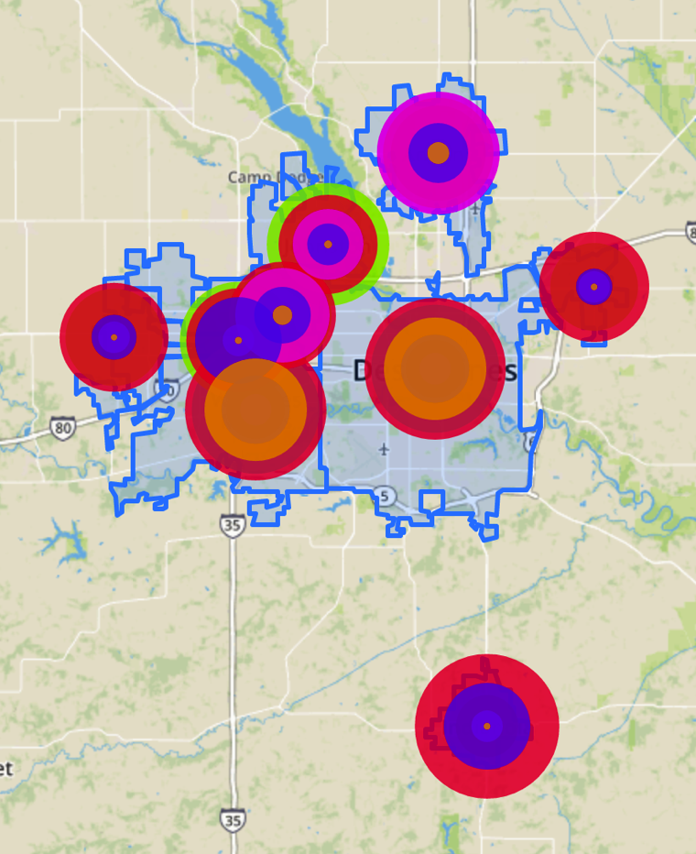
Output
A leaflet map that has layers with circle markers to compare the different values for population, median household income, percent of income spent on housing each month, vacancy rates, and total housing units along with a polygon layer with the city boundaries.

Slide 5
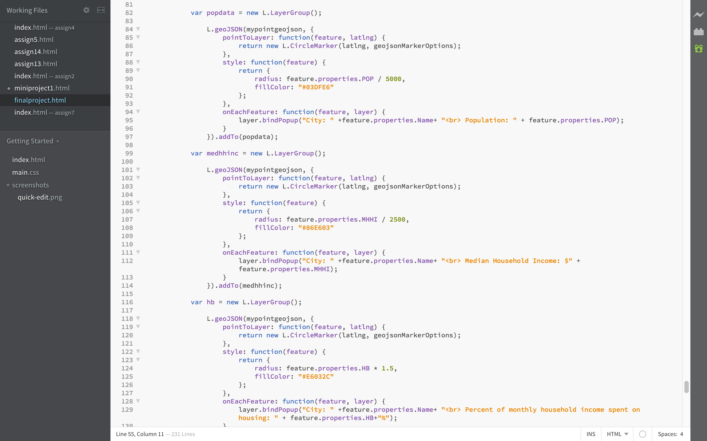

Slide 6
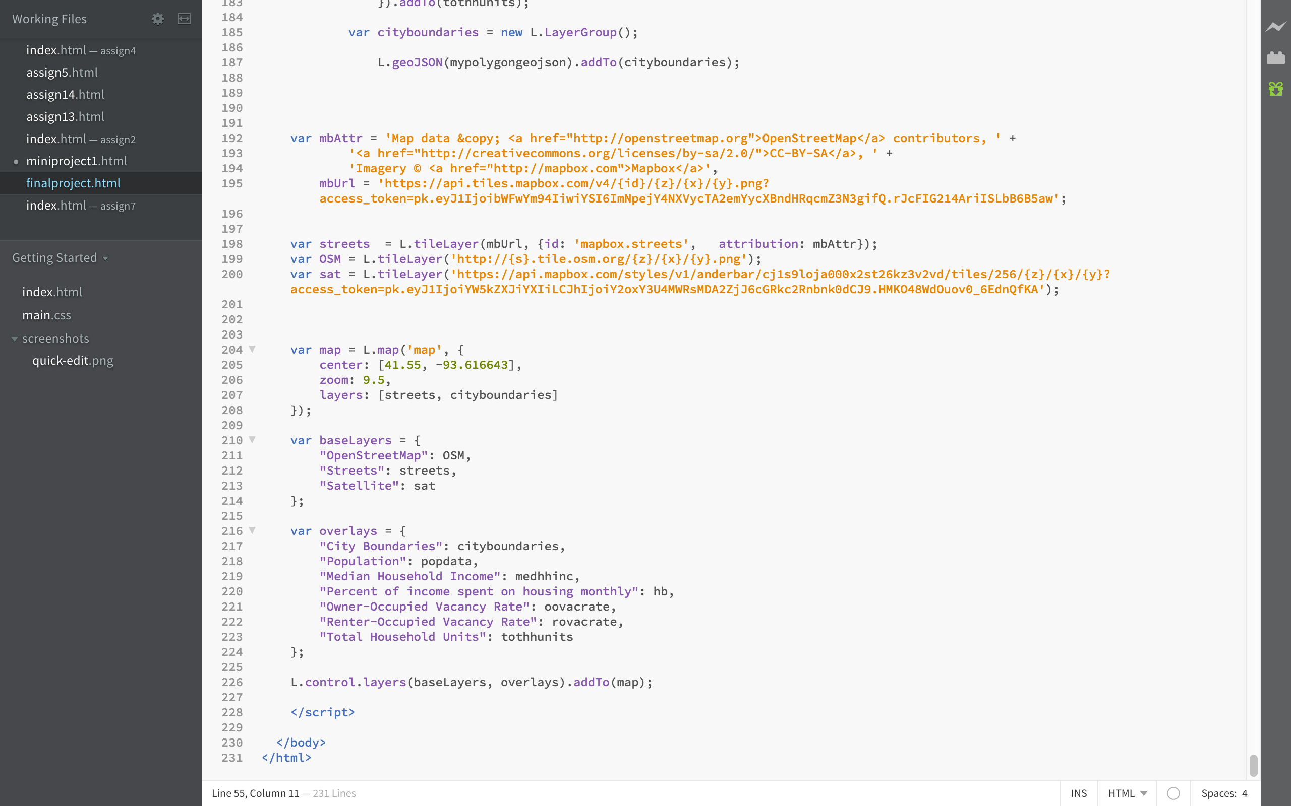

Slide 7
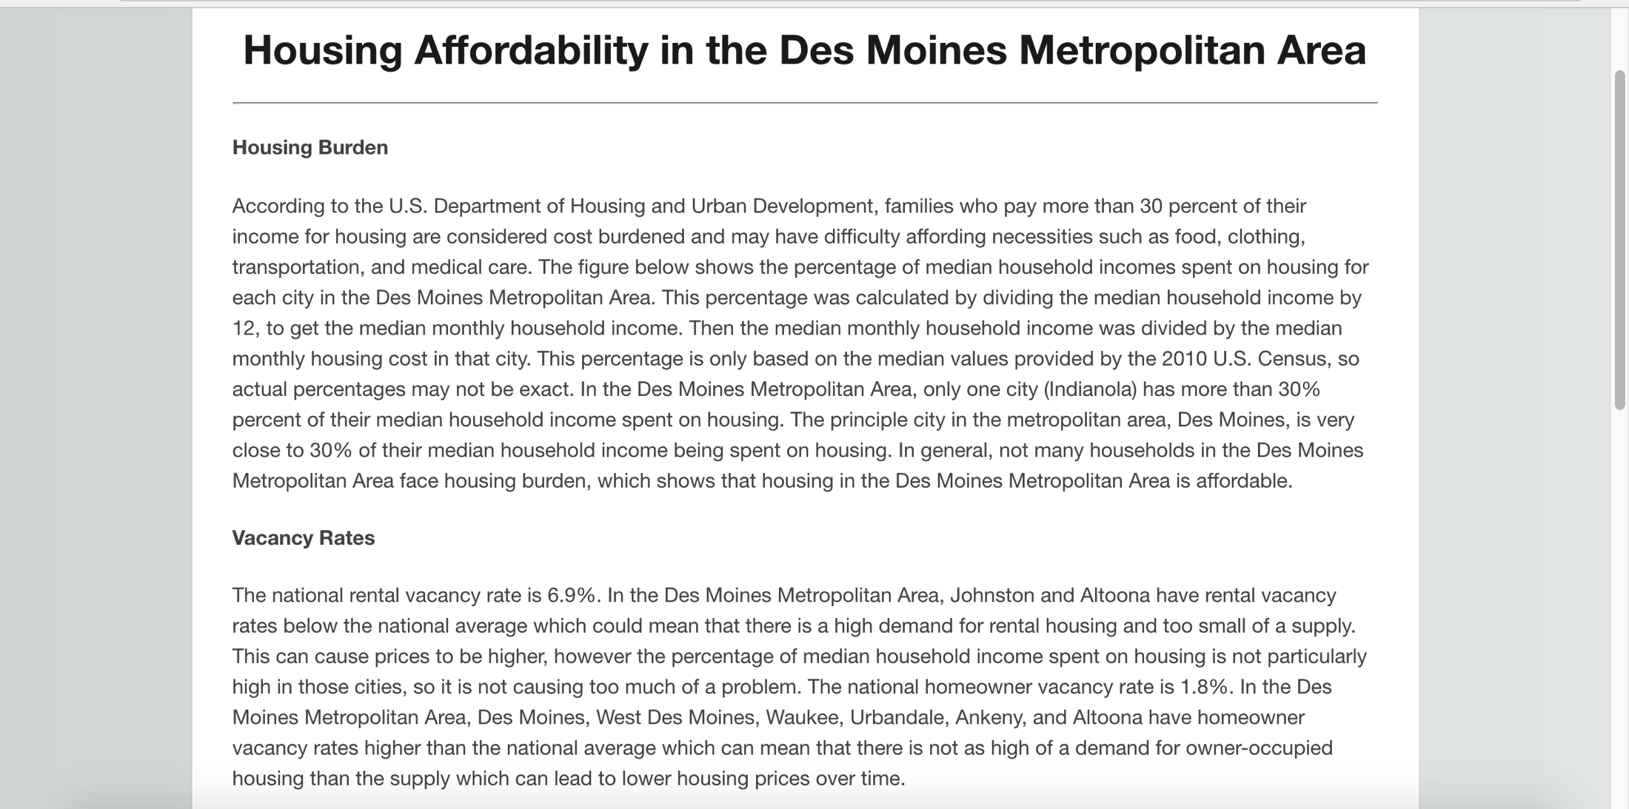
Output (cont)
The site shows all of the relevant statistical factors that affect housing affordability and discusses what the values mean.

